Slide 1
Applied Machine learning
Regent College London
SWE6302

Slide 2
Applied Machine learning
SWE6302

Slide 3

Machine learning
Introduction to Data Science

Slide 4
Module 1 – Introduction to Data Science

Slide 5
Learning objectives
Understand what is Data Science
Understand the type of data
Understand the Mean, Medium & Mode
Understand basic data science techniques

Slide 6
What is Data Science?
Data Science is an interdisciplinary field that uses mathematics, statistics, computer science, and domain knowledge to extract insights and knowledge from data.
Focus: It deals with the entire data lifecycle – from data collection, preparation, analysis, and visualisation, to making data-driven decisions.
Tools & Methods: Includes data preparation, statistical analysis, visualisation, experimentation, process mining, and machine learning.

Slide 7
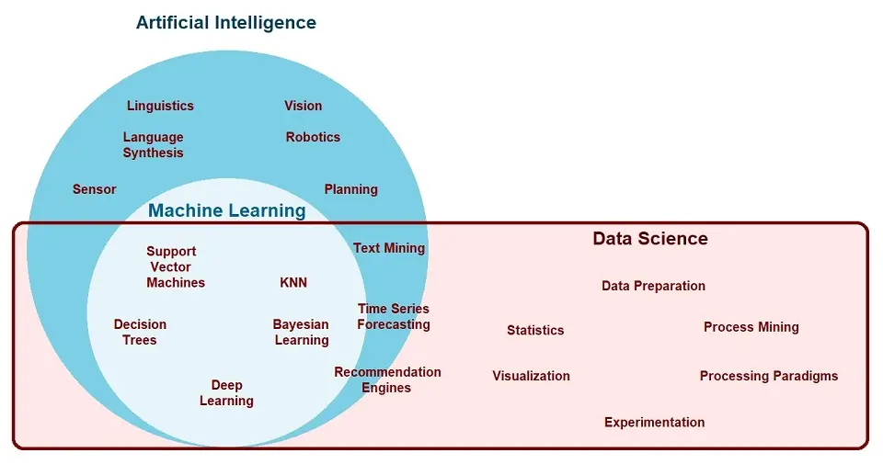
Relationship between Data Science, AI and ML

Slide 8
Relationship between Data Science, AI and ML
Artificial Intelligence (AI): The broad field of creating intelligent systems that can mimic human-like behaviour (e.g., vision, language, planning, robotics).
Machine Learning (ML): A subset of AI that focuses on building algorithms that can learn patterns from data and make predictions/decisions without explicit programming.
Data Science: Provides the data pipeline and analytical foundation that enables AI and ML to work effectively.

Slide 9
Relationship between Data Science, AI and ML
AI is the broadest field.
ML is a subset of AI.
Data Science overlaps with ML — it uses ML algorithms as part of its toolkit, but also covers many non-ML tasks (e.g., statistics, data cleaning, visualisation).

Slide 10
Importance of Data Science in AI and ML
Data Preparation: ML models require clean, structured, and relevant data. Data Science ensures proper preprocessing and feature engineering.
Experimentation: In applied ML, models are iteratively trained and tested; Data Science provides frameworks for experimentation and validation.
Evaluation & Visualisation: Data Science tools help interpret ML results, making them understandable and actionable.
Decision-making: ML outputs become meaningful only when integrated into the wider data-driven decision-making process, which is the domain of Data Science.
End-to-End Pipeline: Data Science bridges the gap between raw data and AI/ML applications, ensuring that models are not just built but also deployed and monitored in real-world scenarios.

Slide 11
What is Feature Engineering in ML
Feature Engineering is the process of transforming raw data into meaningful input variables (features) that improve the performance of machine learning models.
It involves selecting, modifying, or creating new features from existing data to help the model better capture underlying patterns.
Often considered one of the most important steps in ML, since good features can make a simple model perform well, while poor features can make even advanced models fail.

Slide 12
Key steps in Feature Engineering
Data Cleaning: Handling missing values, removing outliers.
Feature Transformation: Normalisation, scaling, encoding categorical variables.
Feature Creation: Creating new variables (e.g., ratios, interaction terms, aggregates).
Feature Selection: Choosing the most relevant features to reduce noise and improve efficiency.

Slide 13
Real world example of Feature Engineering
Predicting house prices 🏡
Raw Data Available:
  Number of bedrooms
  Total area (sq. ft.)
  Year built
  Location (address)
  Distance to nearest city centre
  Sale date
Number of Bedrooms | Total Area (sq. ft.) | Year Built | Location (Address) | Distance to Nearest City Centre (km) | Sale Date
3 | 1,200 | 2005 | 14 King’s Road, York | 2.5 | 2022-07-15
4 | 1,850 | 1998 | 25 High Street, Leeds | 8.0 | 2022-11-10
2 | 950 | 2015 | 72 Green Lane, Bristol | 1.2 | 2023-03-05
5 | 2,400 | 1980 | 18 Park Ave, London | 0.8 | 2022-06-20
3 | 1,500 | 2010 | 9 Church St, Manchester | 5.4 | 2023-01-12

Slide 14
Real world example of Feature Engineering
Feature Engineering Examples:
From "Year built" → Create "Age of house" (Current Year – Year built).
From "Location (address)" → Encode neighbourhood or convert to latitude/longitude features.
From "Sale date" → Extract "Season" or "Month of sale" (houses may sell at higher prices in summer).
From "Distance to city centre" → Create categorical feature (e.g., "Urban", "Suburban", "Rural").
From "Total area & bedrooms" → Create "Average room size" (Total area ÷ Number of bedrooms).
💡 These engineered features often provide stronger predictive power than the raw data itself, since they capture meaningful relationships in the data.

Slide 15
Real world example of Feature Engineering
Feature-Engineered
Housing Data
Assuming the current year is 2025.
Number of Bedrooms | Total Area (sq. ft.) | Year Built | Location (Address) | Distance to Nearest City Centre (km) | Sale Date | Age of House (yrs) | Encoded Location (City) | Season of Sale | City Category | Avg. Room Size (sq. ft.)
3 | 1,200 | 2005 | 14 King’s Road, York | 2.5 | 2022-07-15 | 20 | York | Summer | Urban | 400
4 | 1,850 | 1998 | 25 High Street, Leeds | 8.0 | 2022-11-10 | 27 | Leeds | Autumn | Suburban | 462.5
2 | 950 | 2015 | 72 Green Lane, Bristol | 1.2 | 2023-03-05 | 10 | Bristol | Winter | Urban | 475
5 | 2,400 | 1980 | 18 Park Ave, London | 0.8 | 2022-06-20 | 45 | London | Summer | Urban | 480
3 | 1,500 | 2010 | 9 Church St, Manchester | 5.4 | 2023-01-12 | 15 | Manchester | Winter | Suburban | 500

Slide 16
Feature Engineering in Summary
Feature engineering is about turning raw data into useful signals for machine learning.
It is where domain knowledge meets data science, and in many real-world problems, the quality of features matters more than the choice of algorithm.

Slide 17
Type of data & Statistical analysis
Numerical
Categorical
Ordinal

Slide 18
Numerical
Represents some sort of quantitative measurement:
Heights of people, page load times, stock prices, etc.
Discrete Data:
Integer based; of ten counts of some event.
How many purchases did a customer make in a year?
How many times did I flip “heads”?
Continuous Data:
Has an infinite number of possible values
How much time did it take for a user to check out?
How much rain fell on a given day?

Slide 19
Categorical
Qualitative data that has no inherent mathematical meaning.
Gender, Yes/no (binary data), Race, State of Residence,
Product Category, Political Party, etc.
You can assign numbers to categories in order to represent them more compactly, but the numbers don’t have mathematical meaning

Slide 20

Ordinal
A mixture of numerical and categorical
Categorical data that has mathematical meaning
Example: movie ratings on a 1-5 scale.
Ratings must be 1, 2, 3, 4, or 5
But these values have mathematical meaning;
1 means it’s a worse movie than a 2.

Slide 21
Mean
AKA Average
Sum / number of samples
Example:
Number of children in each house on my street: 0, 2, 3, 2, 1, 0, 0, 2, 0
The MEAN is (0+2+3+2+1+0+0+2+0) / 9 = 1.11

Slide 22
Median
Sort the values, and take the value at the midpoint.
Example:
    0, 2, 4, 2, 1, 0, 0, 2, 0 Sort it:
    0, 0, 0, 0, 1, 2, 2, 2, 4
https://www.youtube.com/watch?v=qglJSIp6n7M

Slide 23
Median
If you have an even number of samples, take the average of the two in the middle.
Median is less susceptible to outliers than the mean
Example: mean household income in the US is $72,891, but the median is only $51,234 – because the mean is skewed by a handful of billionaires.

Slide 24
Mode
The most common value in a data set
Not relevant to continuous numerical data
Back to our number of kids in each house example:
0, 2, 3, 2, 1, 0, 0, 2, 0,0
How many of each value are there?
0: 5, 1: 1, 2: 3, 3: 1
The MODE is 0
https://www.youtube.com/watch?v=xObCUytIVMo

Slide 25
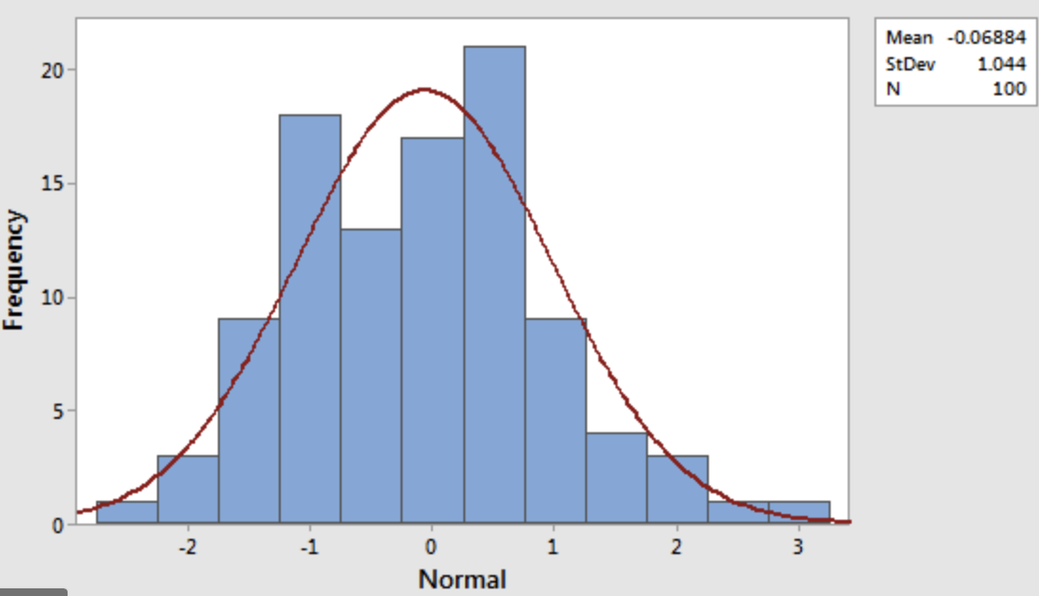
Histogram-normal distribution

Slide 26
variance
Variance measures how “spread-out” the data is.
Variance (𝜎2) is simply the average of the squared differences from the mean
Example: What is the variance of the data set (1, 4, 5, 4, 8)?
First find the mean: (1+4+5+4+8)/5 = 4.4
Now find the differences from the mean: (-3.4, -0.4, 0.6, -0.4, 3.6) Find the squared differences: (11.56, 0.16, 0.36, 0.16, 12.96)
Find the average of the squared differences:
𝜎²= (11.56 + 0.16 + 0.36 + 0.16 + 12.96) / 5 = 5.04
https://www.youtube.com/watch?v=deIQeQzPK08

Slide 27
Standard deviation
𝜎² = 5.04
𝜎 = Sq(5.04) = 2.24
This is usually used as a way to identify outliers. Data points that lie more than one standard deviation from the mean can be considered unusual.
You can talk about how extreme a data point is by talking about “how many sigmas” away from the mean it is.
https://www.youtube.com/watch?v=qqOyy_NjflU

Slide 28
Population vs sample
If you’re working with a sample of data instead of an entire data set (the entire population)...
Then you want to use the “sample variance” instead of the “population variance”
For N samples, you just divide the squared variances by N-1 instead of N.
So, in our example, we computed the population variance like this:
𝜎2= (11.56 + 0.16 + 0.36 + 0.16 + 12.96) / 5 = 5.04 ▫
But the sample variance would be:
𝑆2= (11.56 + 0.16 + 0.36 + 0.16 + 12.96) / 4 = 6.3

Slide 29
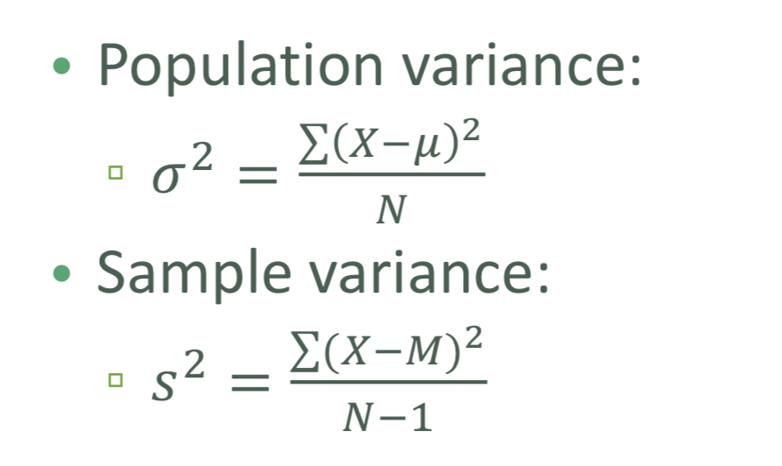
Population vs sample

Slide 30
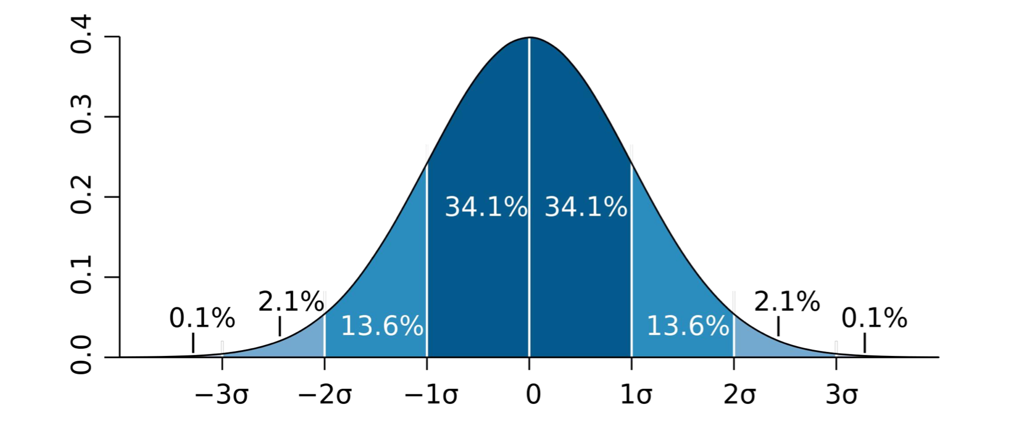
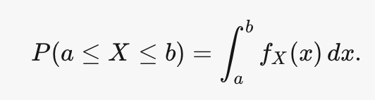
Probability density function
The probability that a random variable X takes a value in the (open or closed) interval [a,b] is given by the integral of a function called the probability density function f_{x}(x) :
https://www.youtube.com/watch?v=Fvi9A_tEmXQ
Gives you the probability of a data point falling within some given range of a given value.

Slide 31
Percentile
A percentile (or a centile) is a measure used in statistics indicating the value below which a given percentage of observations in a group of observations fall.
For example, the 20th percentile is the value (or score) below which 20% of the observations may be found.
https://www.youtube.com/watch?v=Ngyt8Q5tWkU

Slide 32
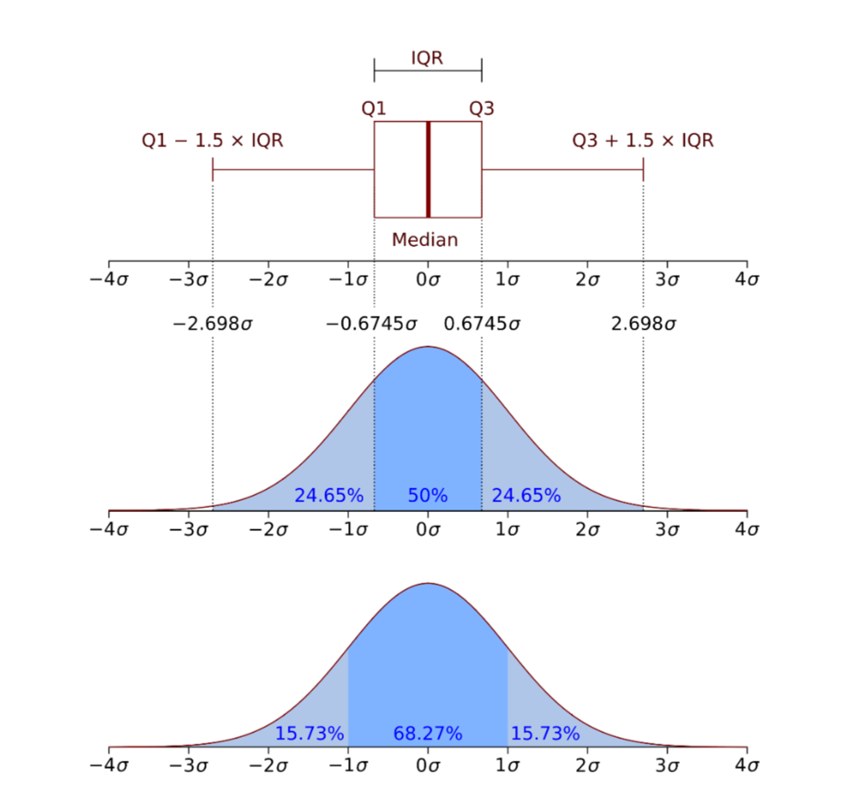
Percentile in a normal distribution

Slide 33
Moments
Quantitative measures of the shape of a probability density function
Mathematically they are a bit hard to wrap your head around:
But intuitively, it’s a lot simpler in statistics.
The first moment is the mean.
The second moment is the variance.

Slide 34
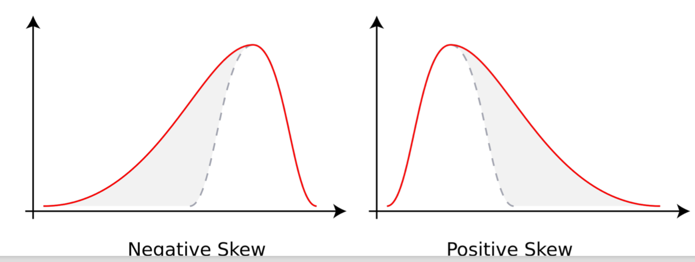
Third Moment
How “lopsided” is the distribution?
A distribution with a longer tail on the left will be skewed left, and have a negative skew.

Slide 35
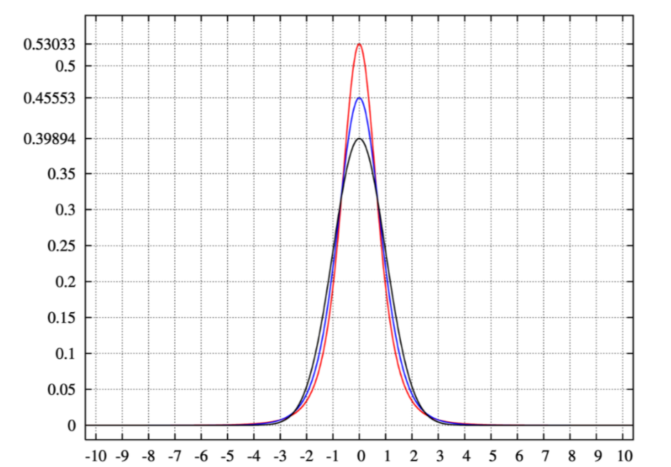
Fourth moment
The fourth moment is “kurtosis”
How thick is the tail, and how sharp is the peak, compared to a normal distribution?
Example:
higher peaks have higher kurtosis

Slide 36
Correlation
Correlation is a term that is a measure of the strength of a linear relationship between two quantitative variables (e.g., height, weight).
Correlation of -1 means a perfect inverse correlation
Correlation of 0: no correlation
Correlation 1: perfect correlation
https://www.youtube.com/watch?v=dsyTQNUvqH0

Slide 37
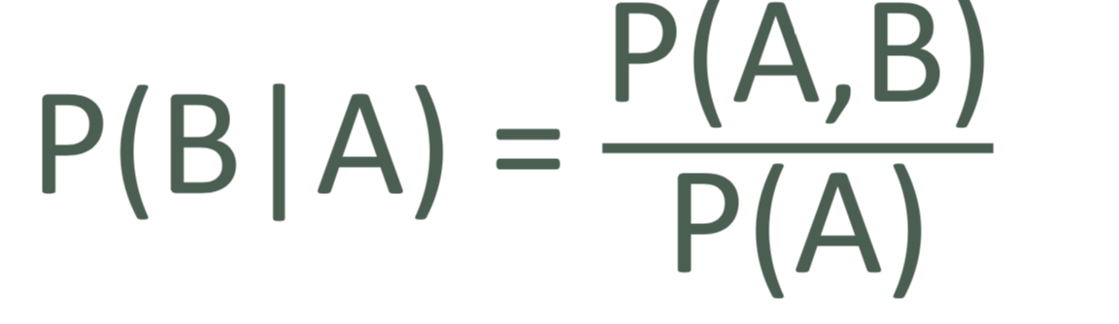
Conditional probabilty
If I have two events that depend on each other, what’s the probability that both will occur?
Notation: P(A,B) is the probability of A and B both occurring • P(B|A) : Probability of B given that A has occurred
We know:

Slide 38
Example
I give my students two tests. 60% of my students passed both tests, but the first test was easier – 80% passed that one. What percentage of students who passed the first test also passed the second?
A = passing the first test, B = passing the second test
So we are asking for P(B|A) – the probability of B given A
P(B|A) = P(A,B) / P(A) = 0.6 / 0.8 = 0.75
75% of students who passed the first test passed the second.

Slide 39
Data science for beginners with python
https://www.youtube.com/watch?v=jNeUBWrrRsQ

Slide 40
+44 (0)207 016 8000
info@rcl.ac.uk
Thank You!

